Slide 1
Stochastic Calculus for Finance: Random Walk
By Sonali Singh
Mentored by Luhao Zhang

Slide 2
This semester, my mentor and I explored Steven Shreve’s textbook, Stochastic Calculus for Finance I: The Binomial Asset Pricing Model. Shreve’s work discusses properties of the binomial asset pricing model, including martingales, Markov processes, and random walk.
Specifically, this presentation will focus on properties in the Random Walk section.

Slide 3
So what is random walk?
Random walk is a stochastic (random) process of discrete steps on a fixed length. The steps do not depend on previous steps.
Symmetric random walk is when the direction of each step (up or down, left or right) is equally likely, meaning p=½. In asymmetric random walk p≠½. However, both types of random walk have the same set of possible paths.

Slide 4
Why is this important?
Random walk can be applied to the prices of securities in the stock market, the movement of microorganisms and cells in biology, and more.
In order to understand the theory behind random walk, let us take a look at two examples.

Slide 5
“A drunk man will find his way home, but a drunk bird may get lost forever.”
– Shizuo Kakutani

Slide 6
Question Breakdown
According to the theory of random walk, for 1- and 2-dimensional spaces, you will return to your starting point with a probability of 1. However, in a 3-dimensional space, there is a positive probability that you will never return to your starting point.
We will consider the 2D and 3D space individually and show how this holds.

Slide 7
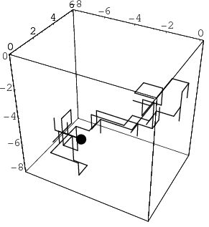
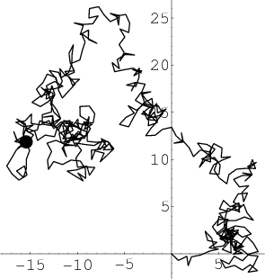
First, note the visual differences in 2D (left) and 3D (right) random walk.

Slide 8
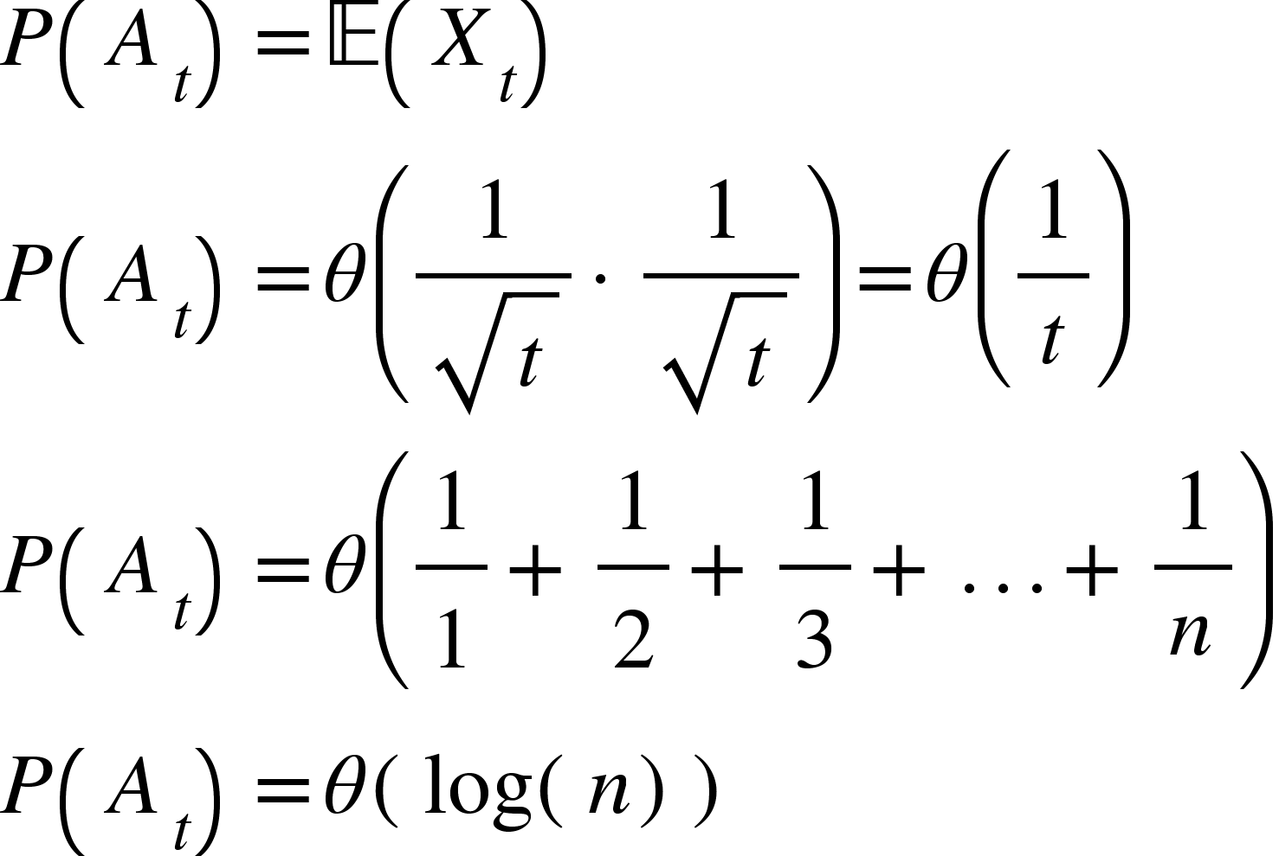
TWO DIMENSIONAL SPACE
Now let us consider the 2D space. Suppose by contradiction that the probability of never returning is greater than 0 (p>0). Then the expected number of visits to the origin is 1/p.
Let A_{t}= event we are at the origin at time 2t when X_{t} is a r.v. Then the expected number of visits to the origin can be shown by:
Note that:
so the probability of never returning cannot be positive (p>0). Therefore for returning to the origin.

Slide 9
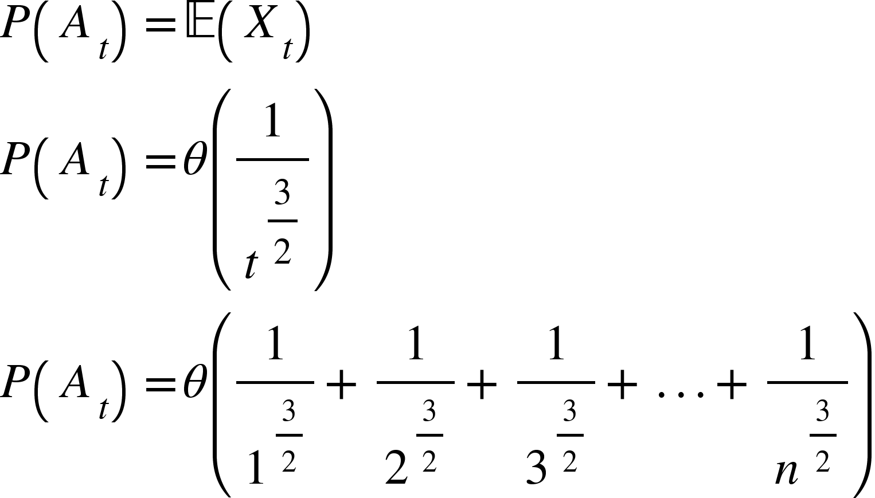
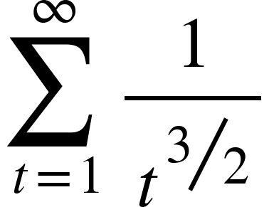
THREE DIMENSIONAL SPACE
Now let us consider the 3D space. Similarly:
Note that in this case:
Is finite. This means:
for never returning. Therefore for returning to the origin.

Slide 10
In an election where candidate A receives p votes and candidate B receives q votes with p > q, what is the probability that A will be strictly ahead of B throughout the count?
Bertrand's Ballot Problem

Slide 11
Question Breakdown
In mathematical terms, the question is as follows:
For a simple random walk {x_{n}}_{0≤n≤T}, what is the probability that x_{n}≥0 for all n in {0, 1, 2, … T} given x_{T}=k?
In order to work this problem, we must understand the concept of a reflected path as detailed by the reflection principle.

Slide 12
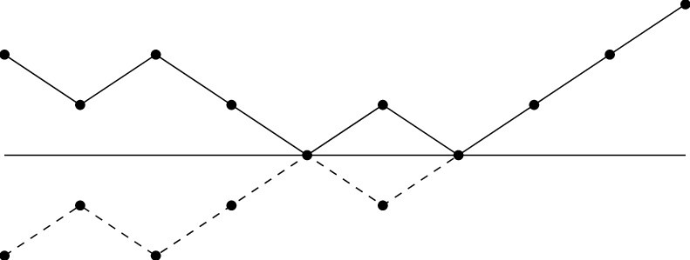
What is the reflection principle?
This principle states if the path of a process reaches some value, say a, at time t, then a “reflected” path after time t has the same distribution as the original path about the value a.
The dotted line shows an example of a reflected path.

Slide 13
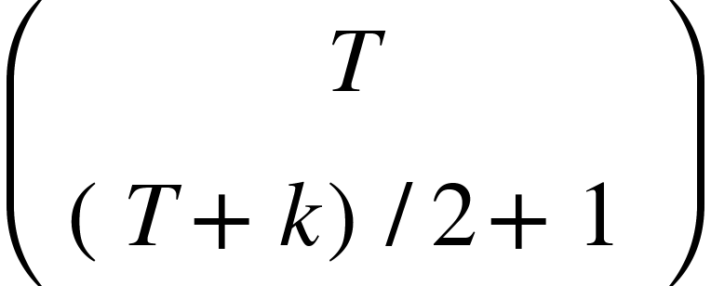
Think of votes for candidate A as steps upward (p) and votes for candidate B as steps downward (q). The total number of votes can be represented by T, and the votes candidate A wins by can be represented by k. Note that since we are interested in the conditional probability of A winning, exact p of an up step or down step does not matter, as shown below:
Note that if the path does not end on or below the x-axis, this means that candidate A has won, so we will call this a favorable path. Every path that starts with a vote for candidate B must reach a tie at some point in order for candidate A to win. By the reflection principle, we can reflect every path that begins with candidate A and reaches a tie up to the point of the first tie to get the candidate B paths. In other words, for every path that has a tie, there are two possible paths via the reflection principle. This is shown by:
Then we can conclude:

Slide 14
TAKEAWAYS
Random walk represents a pattern of discrete steps in a certain dimension that occur with probability p. The steps are independent of previous steps.
The probability of returning to the origin in a 2D space (coordinate plane) is 1, but there not a definite 1 probability of returning to the origin in a 3D space.
The reflection principle, associated with random walk and Brownian motion, describes properties of random walk paths that are reflected over the x-axis.

